Slide 1



Juan Jesús Ávila Mota
Academia Java Xideral
Examen Semana03

Slide 2
PROGRAM WITH JUnit

Slide 3
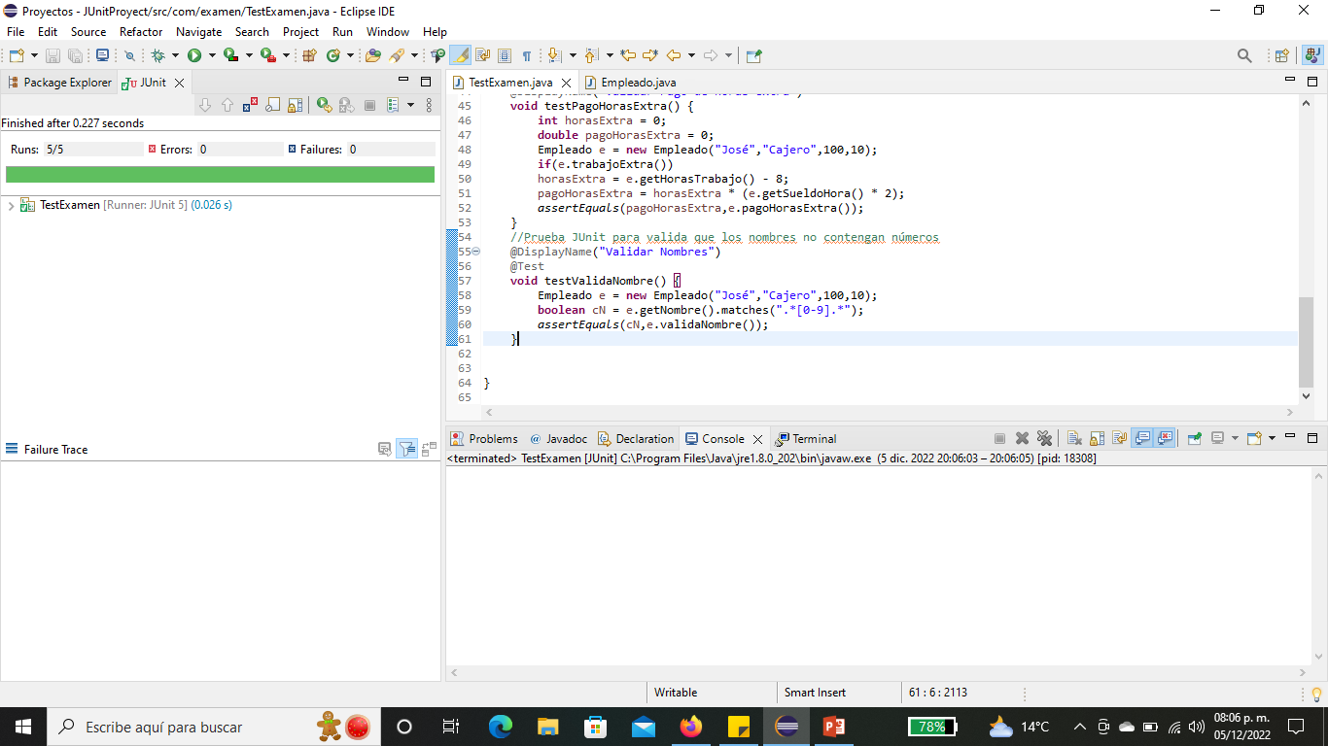

Slide 4
TDD was used in this program, that is, the JUnit tests were programmed first and later the class was created with its attributes and methods, where it is validated if the employee worked overtime and what was the payment for these hours which are paid to the double

Slide 5
SCRUM

Slide 6
11 important points have been established to implement SCRUM, this methodology is not a recipe that must be followed specifically, it is implemented according to the purpose and better adaptability of the project and the team

Slide 7
2.- Select a good work team, the people who are part of the team are capable of understanding the vision of the product owner and turning the vision into reality, the team to be a small team of 3 to 9 people.
1.- It is necessary to establish the person responsible for the product, Product Owner.
It has the vision of what is going to be done, produced, achieved and the rewards of the project.
3.- Select the Scrum Master, who will be in charge of integrating the team into the SCRUM methodology and eliminating what harms the team.
6.- Plan the Sprint, this is the first meeting, the product owner, Spring Master and the team, the sprints have a fixed duration of less than one month, based on the log it is planned how long the sprint can take, not this subject to change.
5.- Refine the log, together with the work team, estimate the effort that is carried out in each of the listed activities and verify if they can be carried out correctly with the resource that is available.
4.- Create the product log, a list of what has to be done in order to turn the vision into reality, applying emphasis on what is a priority.

Slide 8
7.- Make the work visible, create a Scrum table with three columns, pending, in process, finished, posticks represent the processes that are carried out and change columns depending on the status of the element.
8.- Daily Scrum, meeting no longer than 15 minutes, the team answers three fundamental questions:
What did you do yesterday to help the team finish the sprint? What will you do today to help the team finish the sprint? Are any obstacles preventing you or the team from meeting the sprint goal?
9.- Review of the Sprint, what was done during the Sprint is shown, everyone involved can attend, from the client to the entire Scrum team, which team demonstrates what is considered 100% finished
10.-Feedback from the Sprint, where you have an item from the finished log and ask what can be done to improve? What was done well? What can be done faster? Taking into account the maturity of the team and the trust that exists between them
11.- Start the Sprint again, with possible improvements, due to the experience acquired by the team

Slide 9
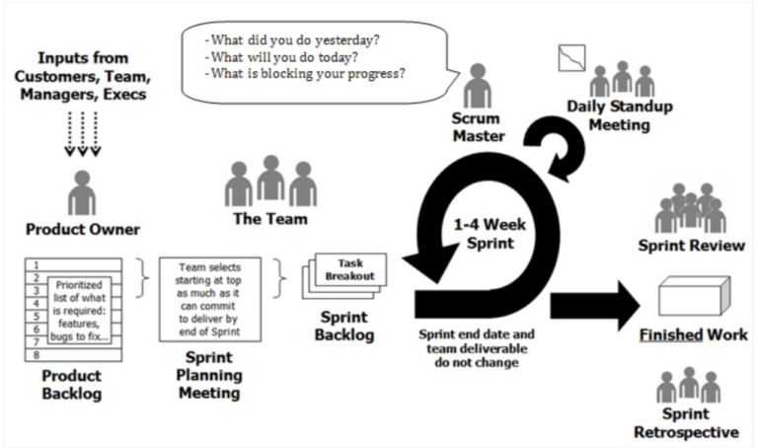

Slide 10
Crud web Servlets

Slide 11
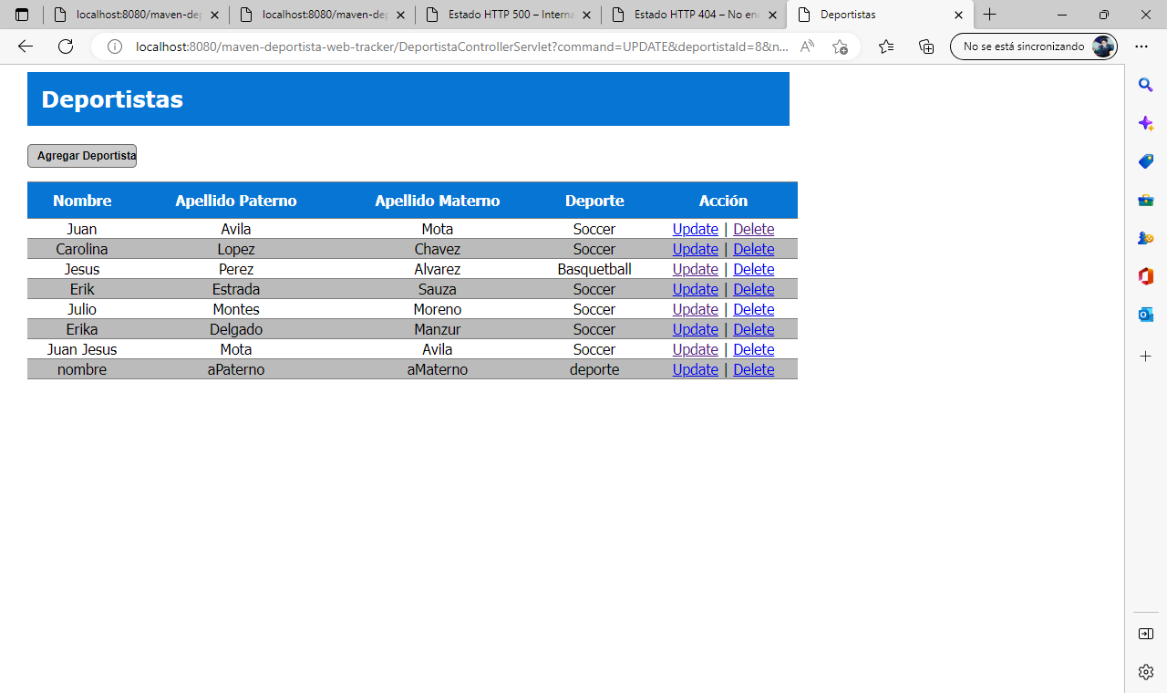

Slide 12
The program shown is a CRUD which uses servlets and jsp, as well as MVC with an architecture in which the model takes the role of interacting with the database through JDBC.
The database was created in MYSQL, where athlete data is stored.
Dependencies were pulled in using Maven

Slide 13
Crud web Spring and hibernate

Slide 14
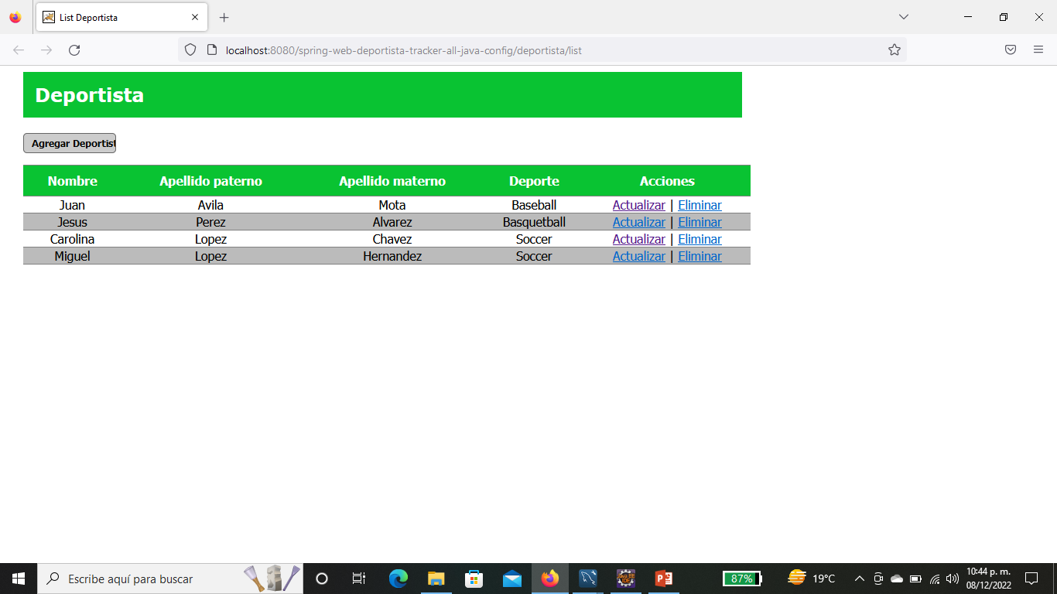

Slide 15
The program is a crud using Spring and Hibernate, these frameworks, minimize the lines of code obtained in the previous exercise, seeing the fundamental purpose of any framework.
Being Hibernate capable of mapping the data extracted from the database and sharing this information through the Java files that make up the project.
The dependencies were pulled in via Maven.

Slide 16
Spring batch

Slide 17
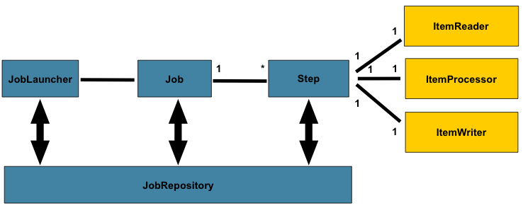

Slide 18
Spring batch is thinking about memory processing. This repository is used mainly for writing, although it is also consulted to check if a file has already been processed previously.
ItemReader: Handles reading from batch processing. This reading can be, for example, from a database; Or it could also be from a message broker or a csv, xml, json, etc. file.
ItemProccessor: is in charge of transforming previously read items. This transformation, in addition to including changes in the format, can include data filtering or business logic.
A job is a block of work and is made up of one or several steps. Once all these steps have been carried out, the job is considered complete.
ItemWriter: este elemento es lo opuesto al itemReader. Se encarga de la escritura de los ítems. Esta puede ser inserciones en una base de datos, en un fichero csv, en un broker de mensajes, etc.

